Slide 1
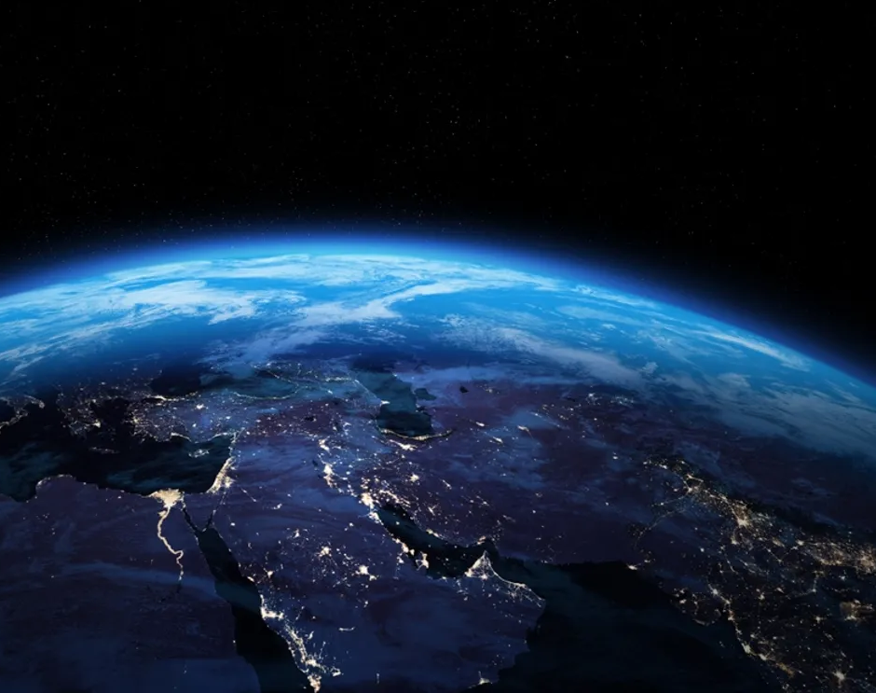
All The Earth Will Sing Your Praises

Slide 2
D A
You lived, You died,
Bm G D
You said in three days You would rise
A Bm D
You did, You're alive

Slide 3
D A
You rule, You reign
Bm G
You said You're coming back again
D A
I know You will
Em G D A Bm G
All the earth will sing Your praises

Slide 4
D A Bm G
You took, You take our sins away oh God
D A Bm G
You give, You gave Your life away for us

Slide 5
Em
You came down,
Bm
You saved us through the cross
Em
Our hearts are changed
G A
because of Your great love

Slide 6
D A
You lived, You died,
Bm G D
You said in three days You would rise
A Bm D
You did, You're alive

Slide 7
D A
You rule, You reign
Bm G
You said You're coming back again
D A
I know You will
Em G D A Bm G
All the earth will sing Your praises

